Slide 1
AI, ML, DL & Related Topics
(Refresher)

Slide 2
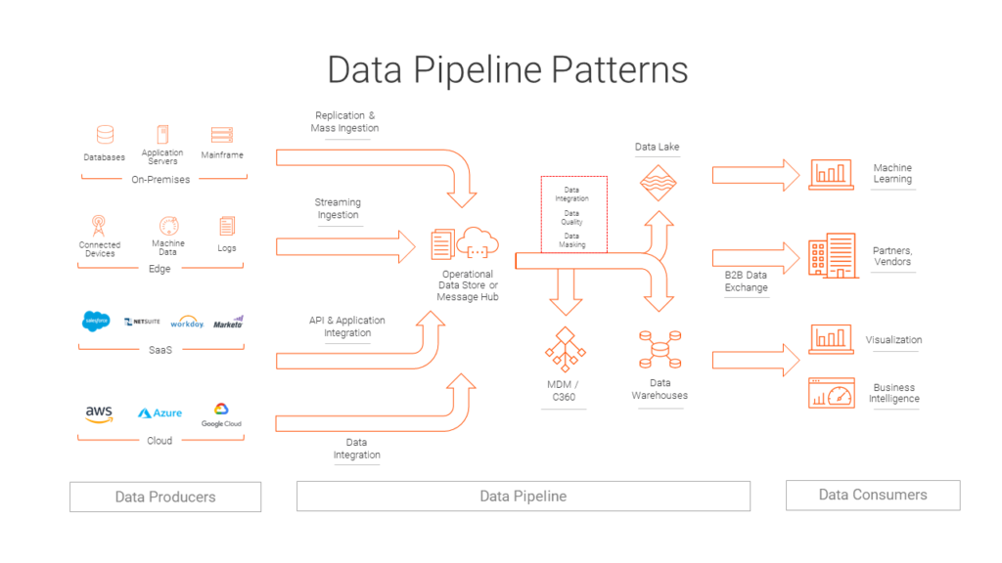
Data Pipeline
For Further Exploration –
Data Engineering Pipeline
The 6 Categories of Data
DB Types
Also , can refer Data (Engineering) slides in the “Software Architecture and Patterns “ Training Session Slides

Slide 3
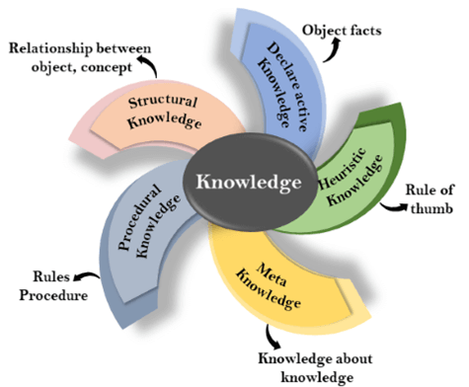
Knowledge Representation
For Further Exploration –
Knowledge Based Agent
A Knowledge Representation Practionary
Data types In Machine Learning

Slide 4
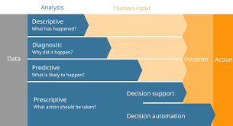
Data Analytics Types
For Further Exploration –
8 Types of Data Analysis
What Is Diagnostic Analytics? How It Works and Examples

Slide 5
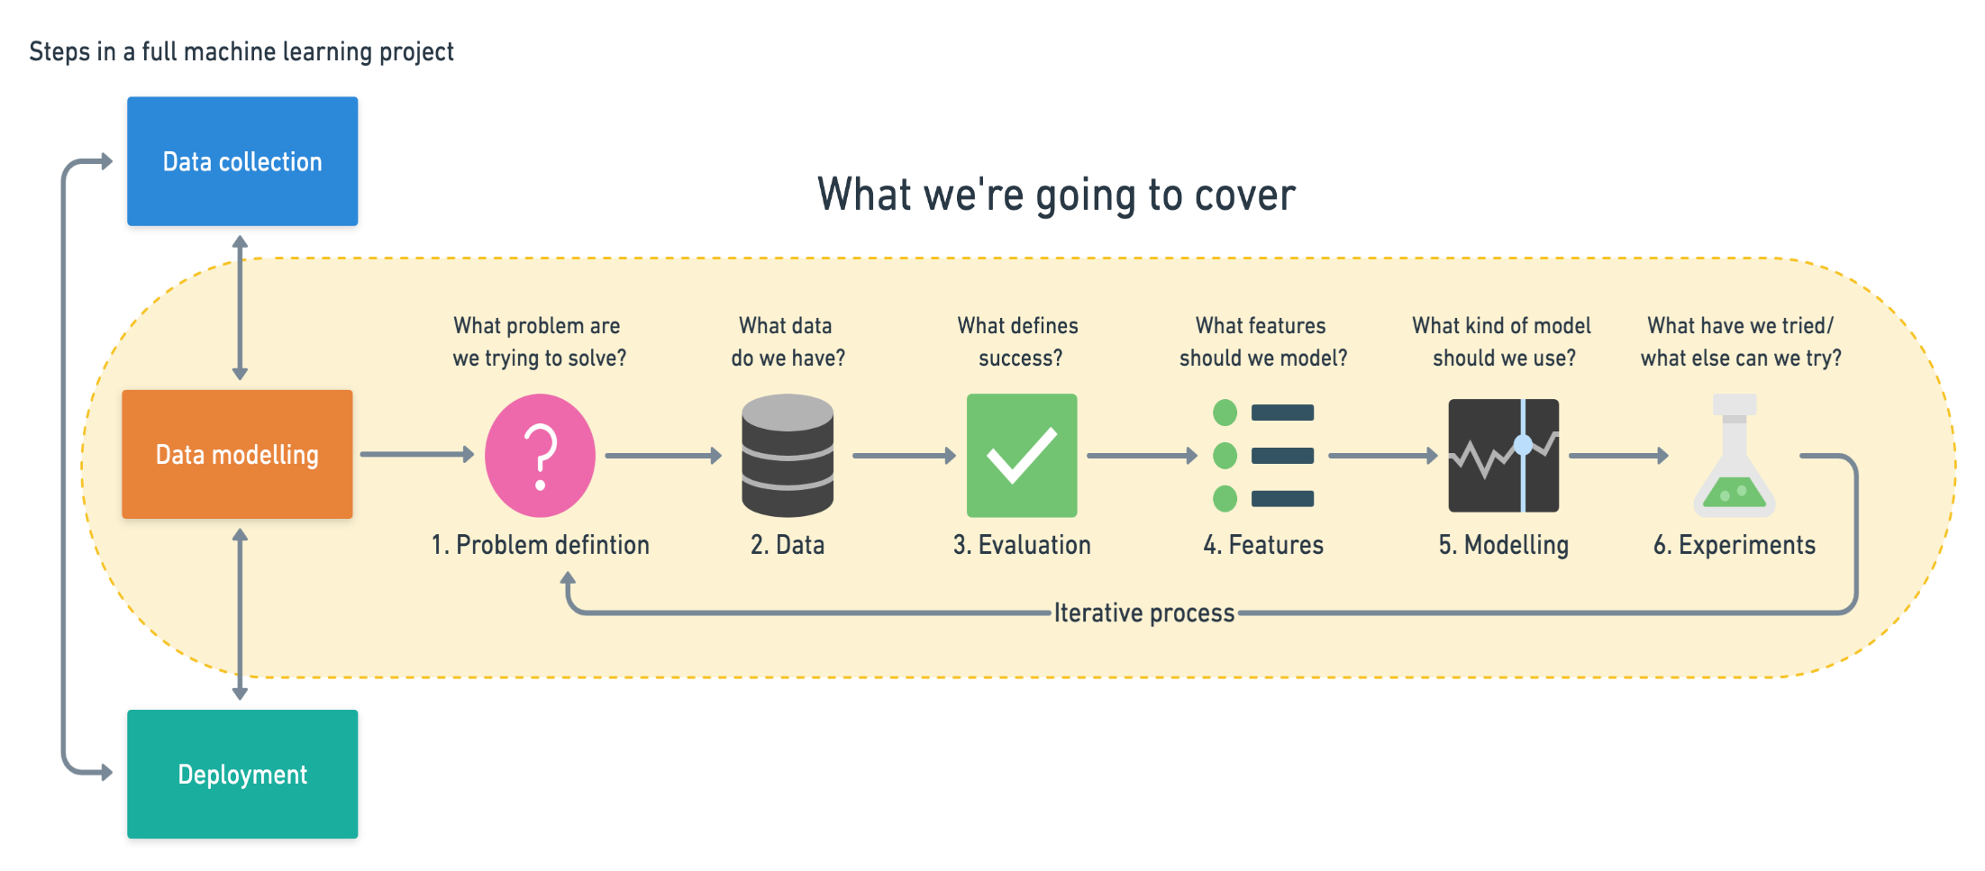
ML Workflow
For Further Exploration –
Introduction to CRISP DM Framework for Data Science and Machine Learning

Slide 6
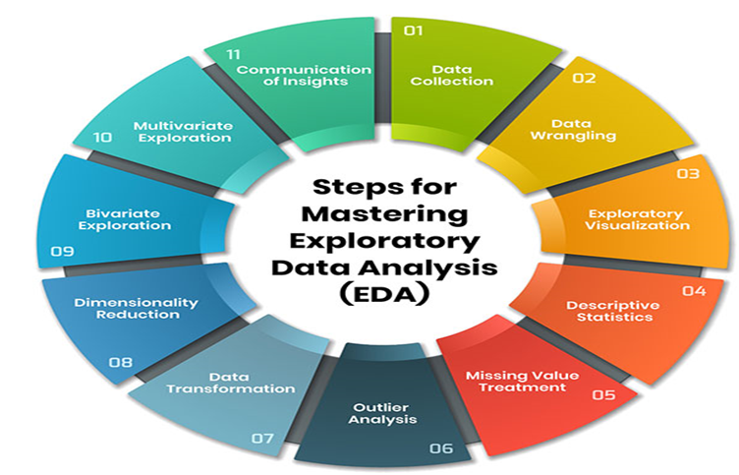
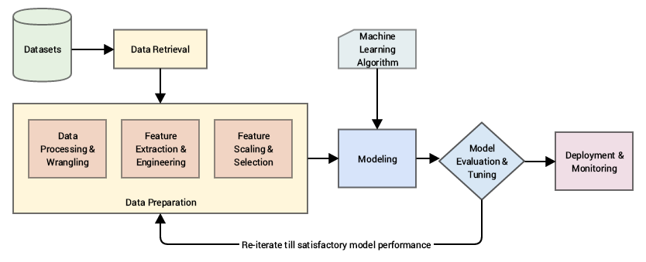
EDA(Exploratory Data Analysis) And Feature Engineering
For Further Exploration –
Data Cleaning In 5 Easy Steps + Examples
A Comprehensive Guide to Mastering Exploratory Data Analysis
Detecting and Treating Outliers | Treating the odd one out!
Data Leakage in Machine Learning - MachineLearningMastery.com
Data Science from Scratch
Fundamentals of Data Visualization
What is Feature Engineering?
What is Feature Scaling and Why is it Important?
Feature Selection in Machine Learning
Transfer Entropy for Feature Selection
Assumption Selection and Feature Selection
Categorical data: Feature crosses
Python-Feature-Engineering-Cookbook
Feature Engineering for Machine Learning

Slide 7
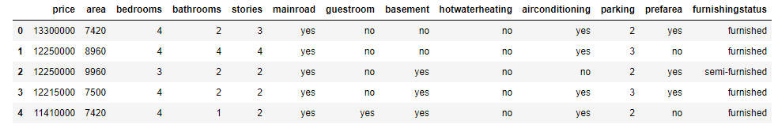

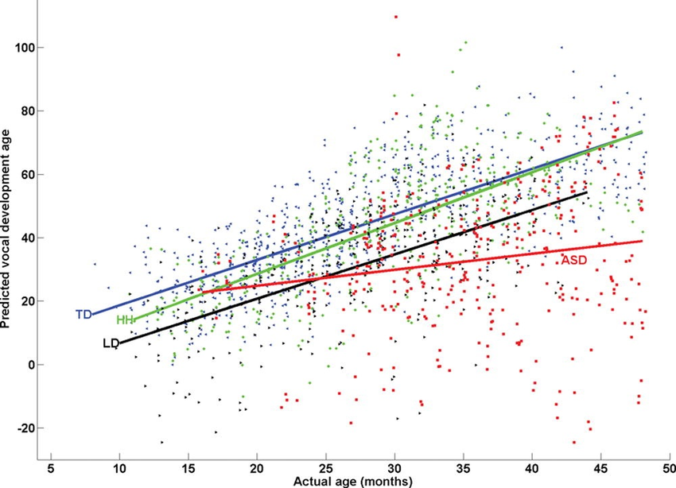
Predictive Analytics Intro Example & y = f(x)
Most AI/ML/DL etc Algorithms’ intent is to find f(x) in “y = f(x)” based on data provided for x(& y). Mainly x & y here are multivariable(i.e. a variable that can contain many values at different times of measurements) i.e. tabular data of samples of x(& y) e.g. as below –
And such f(x) is called parametric model. There are other models also called non-parametric models that will be discussed later.

Slide 8
Maths for AI, ML, DL etc
i) Statistics & Probability - Very helpful for Descriptive Analytics(including EDA[Exploratory Data Analysis] & to some extent DV[Data Visualization]) & can provide non-deterministic/probabilistic values as needed by Linear Algebra data representation below. Also, can be helpful in handling uncertainity, quantifying likelihood, assessing model performance etc. ii) Linear Algebra - Representing (non-)deterministic values in the form of sparse(/dense) vectors/matrices in efficient array or other structures & further (parallel) processing like inferential statistics(for non-deterministic values), proximity measures(e.g. distance or similarity[in general normalized-distance = 1 - normalized-similarity]), matrix factorizations etc to gain insights via proper model development. iii) Multivariable Calculus - mainly used for optimizing the (hyper)parameters of the model or representing the Scientific ML Modelling equations(similar to linear regression).Again here (hyper)parameters can be stochastic as well wherein the values in general are non-deterministic/probabilistic. iv) Topology/Geometry - Topological/Geometric Intuition behind the Probability, Linear Algebra & Calculus above & Image Analysis/Interpretation/Processing in general. By the way, Graph is a special case of Topology. Basically, Graphs have normal nodes & straight edges while Topology has faces(of any shape as well alongwith facial nodes[i.e. nodes having faces], curved edges, metrics i.e. measurements like length, area, volume but lengths and areas are possible in Graphs as well). v) Information Theory – Mainly used to measure Data Quality. To quantify the amount of info(a.k.a entropy) & measure the accuracy, available in the data sources which ultimately leads to better predictive models. Also, can be helpful in good feature selection, decision tree building, cross-entropy loss, Viterbi Algo(commonly used in NLP) & even encoder-decoder modelling which is at the heart of any Transformer implementation which is the backbone of any DL/LLM/GenAI tool.
For Further Exploration –
Some Great Resources to understand the Maths Behind AI
Coding The Matrix
9 Distance Measures in DataScience
Green Tea Press – Free books by Allen B. Downey
Algorithms for Optimization
Bayesian Optimisation
Bayesian Modeling and Computation in Python
Probability Models for Computer Science
An Introduction to Topological Data Analysis

Slide 9
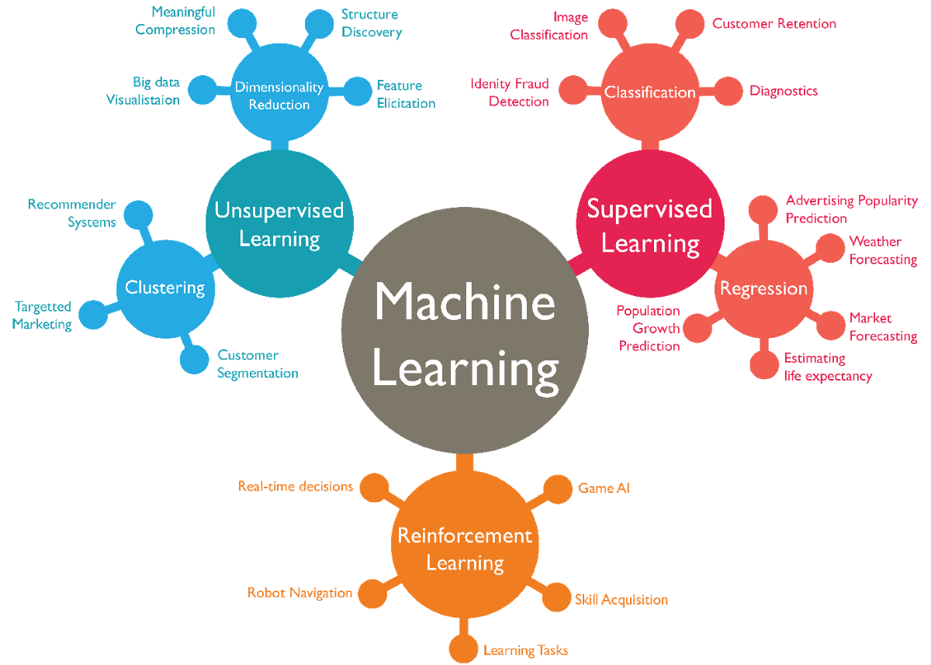
ML Types & Algorithms
N.B. - Some ML algos are based on parametric models while some are based on non-parametric models but most DL algos are based on parametric models
For Further Exploration –
4 Types of Learning in Machine Learning Explained
A Tour of Machine Learning Algorithms
Parametric and Nonparametric Machine Learning Algorithms - MachineLearningMastery.com
What are Parametric Algorithms in Machine Learning??
Algorithm & component reference

Slide 10
Supervised vs Unsupervised vs Semisupervised vs SelfSupervised vs Reinforcement Learning
Supervised Learning – Both x & y are known in general for y = f(x)
Regression - mainly represented by equations e.g. y = ax + b and here y is some numerical value while x can be numerical or categorical data
Classification – mainly represented by inequalities which detects specified regions/classes e.g. if ax+b > m then o/p data belongs to some class1 else class2.here y in general is some categorical data.
Unsupervised Learning – for y = f(x), y is not known but x known
Clustering/Grouping - e.g. doing customer segmentation for marketing/sales Analytics to find groups of customer sales(may be as per regions)
Association Learning - e.g. finding an inference that nappies & baby powder are bought together & so they should ideally be placed nearby in a physical retail store for more sales
Dimensionality Reduction - It’s always advisable to reduce dimensions as much as possible without losing any valuable info, to minimise the “Curse of Dimensionality”.
Semi Supervised Learning – Mainly used for classification tasks and generally Unsupervised Learning is done 1st to find the legitimate clusters/classes & the Supervised Learning used to infer the actual class.
Self-supervised learning – This is a machine learning paradigm where models are trained using the data itself to generate supervisory signals, rather than relying on externally provided labels. It leverages the inherent structure and relationships within unlabeled data to create pseudo-labels for training. This approach is particularly useful when labeled data is scarce or expensive, as it allows models to learn valuable representations from vast amounts of
Reinforcement Learning - The purpose of reinforcement learning is for the agent to learn an optimal (or near-optimal) policy that maximizes the reward function or other user-provided reinforcement signal that accumulates from immediate rewards.
N.B. - Some ML algos are based on probabilistic models while some are based on deterministic models but most DL algos are based on probabilistic models. Refer next slide for the same.
For Further Exploration –
Machine Learning Algorithms
Which machine learning algorithm should I use? - The SAS Data Science Blog
Machine Learning Cheat Sheets
Machine-Learning-Algorithms
Mastering-Machine-Learning-Algorithms
HandsOn-Unsupervised-Learning-with-Python
Hands-on Unsupervised Learning Using Python

Slide 11
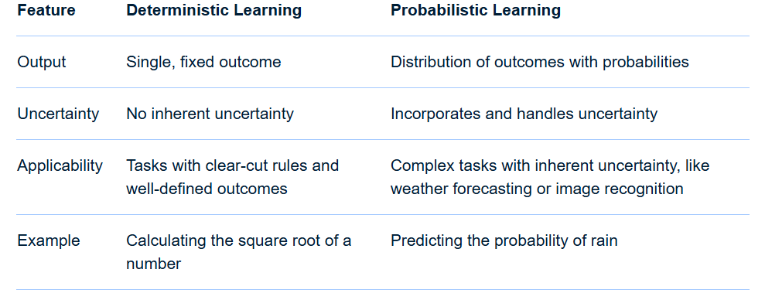
Deterministic vs Probabilistic Learning
In essence: Deterministic learning provides a clear and precise answer, while probabilistic learning offers a range of possibilities and their likelihoods, allowing for a more nuanced understanding of uncertain situations.
For Further Exploration –
Probabilistic vs. Deterministic Models in AI/ML: A Detailed Explanation
What is Deterministic/Probabilistic Data? | Definition from TechTarget
Probabilistic and Deterministic Results in AI Systems - Gaine Technology
What is the difference between deterministic and stochastic models?
Deterministic vs Stochastic - Machine Learning Fundamentals

Slide 12
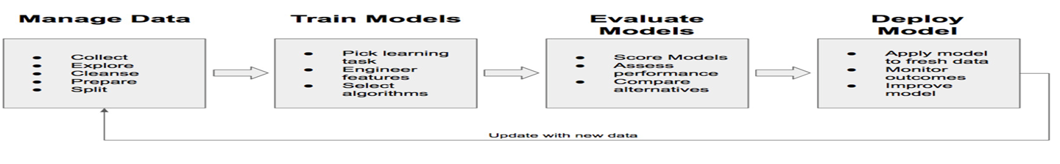
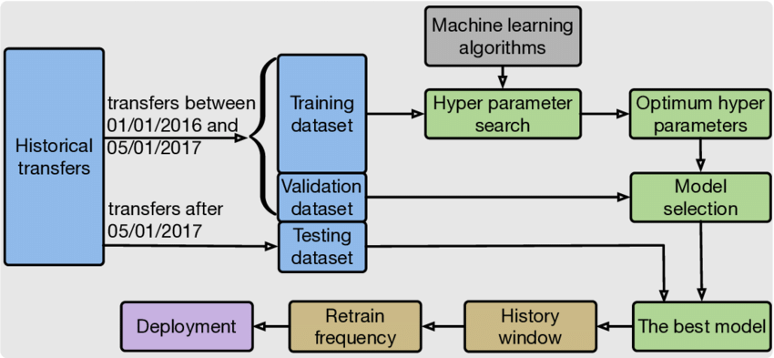
ML Modelling Workflow
For Further Exploration –
Steps in Machine Learning: A Comprehensive Guide
4 Stages of the Machine Learning (ML) Modeling Cycle
About-loss-and-loss-functions
The-Little-Book-of-ML-Metrics
Calibration of Machine Learning Models
How to select a machine learning algorithm - Azure Machine Learning | Microsoft Learn
Machine Learning Algorithm Cheat Sheet
Hands-On-Simulation-Modeling-with-Python
PracticalSimulations
Instance-based vs Model-based Learning

Slide 13
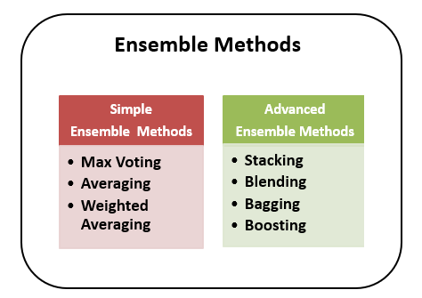
Ensemble Learning
For Further Exploration –
Ensemble Methods in Machine Learning - Prwatech
Ensemble Learning Algorithms Cheatsheet
ensemble-methods-notebooks
Ensemble-Machine-Learning-Cookbook
Hands-On-Ensemble-Learning-with-Python

Slide 14
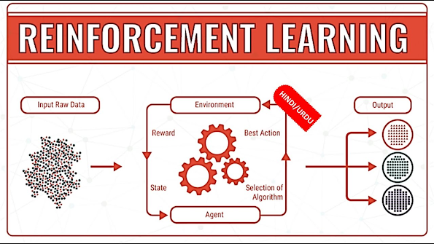
Reinforcement Learning
For Further Exploration –
Reinforcement Learning, Intuition, and Abductive Reasoning
Algorithms for Decision Making
Some Good RL Resources – I
Some Good RL Resources - II

Slide 15
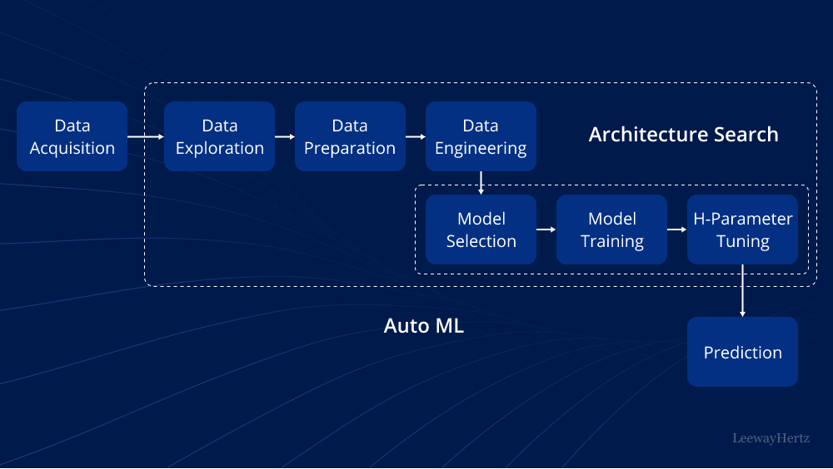
AutoML(Search for Best ML/DL Architecture)
For Further Exploration –
AutoML: Components, techniques, working, tools, platforms and use cases
Awesome-AutoML
Awesome-AutoML-Books

Slide 16
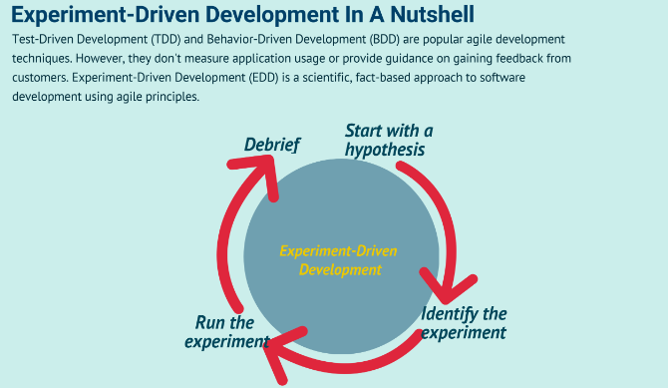
Experiment Driven Development(using A/B [Statistical] Testing)
Feature Flags(based frameworks) can be useful for A/B Testing.
For Further Exploration-
Experiment-Driven Development In A Nutshell
Experimentation-driven development
Experiment Driven Development
How to apply hypothesis-driven development
Data-driven hypothesis development
Micro-Experiments and Experiment Driven Development
A/B Testing Simplified: Steps to Data-Driven Decisions
A/B testing - Wikipedia
15 Math Concepts Every Data Scientist Should Know (Check especially Chapters 2 & 7 for A/B Testing)
A/B Testing Statistics: An Intuitive Guide For Non-Mathematicians
A/B Testing: A Complete Guide to Statistical Testing
A/B Testing Statistics Made Simple
Statistical Significance in A/B Testing
A-B-Testing
The ultimate guide to A/B testing
Experimentation for Engineers: From A/B Testing to Bayesian Optimization
A Summary of Udacity A/B Testing Course
Experiment-Driven Development: A/B Testing and Beyond with AI

Slide 17
Further References
dipanjanS/practical-machine-learning-with-python
How to Handle Big-p, Little-n (p >> n) in Machine Learning - MachineLearningMastery.com
Semi-Supervised Learning: Techniques & Examples
Artificial Intelligence: A Modern Approach, 4th US ed.
Hands-On Machine Learning with Scikit-Learn, Keras, and TensorFlow: Concepts, Tools, and Techniques
Trevor Hastie Books
valeman/awesome-conformal-prediction
Speech and Language Processing
Representation Learning for Natural Language Processing | SpringerLink
Transfer Learning vs Fine Tuning LLMs: Differences
awesome-llm-books: Awesome LLM Books: Curated list of books on Large Language Models
dangkhoasdc/awesome-vector-database
graphgeeks-lab/awesome-graph-universe
Computer Vision and Deep Learning Courses - CVDL Master
Generative models vs Discriminative models for Deep Learning.
Decoding Generative and Discriminative Models | Analytics Vidhya
Generative Deep Learning: Teaching Machines To Paint, Write, Compose, and Play
The Theory and Practice of Enterprise AI - Book
Agentic Artificial Intelligence
Covariance vs. Correlation: Differences to Know | Built In
Introduction to the Correlation Matrix | Built In
Analysis of covariance – Wikipedia
Intuition Behind Kernels in Machine Learning | Baeldung on Computer Science
What is Classification Threshold | Iguazio
Ridhima Kumar – Medium
Venkat Raman | LinkedIn
Explanatory Model Analysis

Slide 18
Thank You

